Slide 1
NIMC Hazard Assessment & Abatement
Forestry Management Leadership Team
Port McNeil l - October 22, 2013
Pete Laing, RFT – Quinsam Fire Base

Slide 2
Hazard Assessment and Abatement
Intro – experience & certification
Intro - opinion, professional obligations, official obligations
Presentation overview – Coastal Fire Centre overview, statutory obligations/interpretations, assessment, best practice, abatement
Context/perspective; interpreting law into appropriate actions
Weather stations statutory obligations & options
Comments, questions and discussion

Slide 3
Coastal Fire Centre Overview
Current practice, guidance and approaches are being reviewed Regionally and Provincially
Coastal fuel types are being reviewed (FBP)
Coastal has identified concerns with some practice (assessment & abatement) within Fire Centre boundaries
Resource Management Burn Plans

Slide 4
OBSCR
New legislation has stalled; release for fall 2013 pushed back
Less restrictive regulations potentially in secondary zones
Primary zones likely staying the same or possibly more restrictive

Slide 5
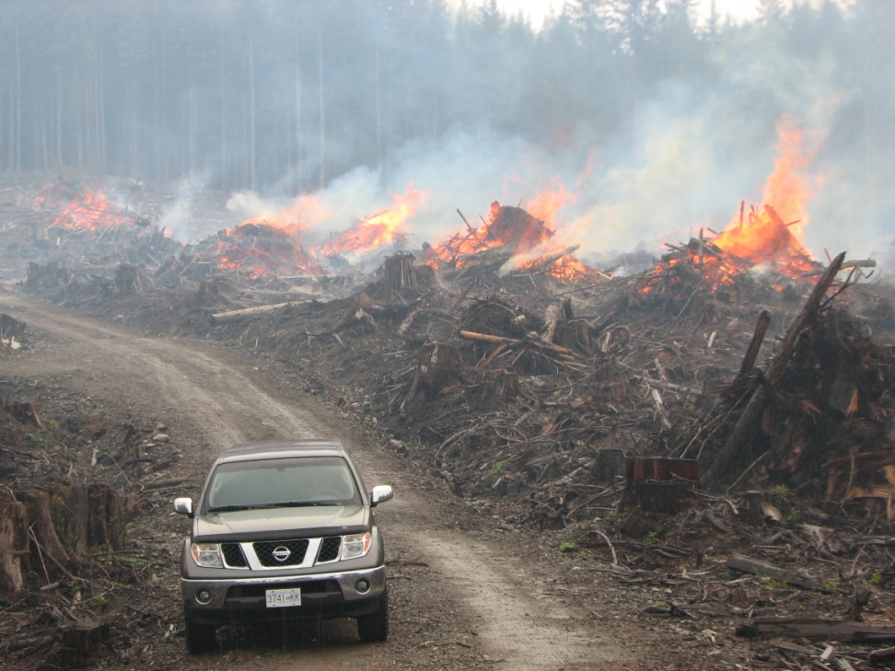
Statutory Obligations
The Wildfire Act & Reg.
Professional Reliance/results based
Prescriptive requirements
Qualified holders

Slide 6
HAZARD ASSESSMENT
Wildfire Reg. states that hazard assessment must be completed;
  Every 3 months while operating within, or within 2 km, of local government boundaries as defined in the WA (Interface) – WR 11(2)
  6 months everywhere else – WR 11(3)
  Option for qualified holder to complete assessments as specified by an RPF or RFT (rationale required) – WR 11(3.1)(b)

Slide 7
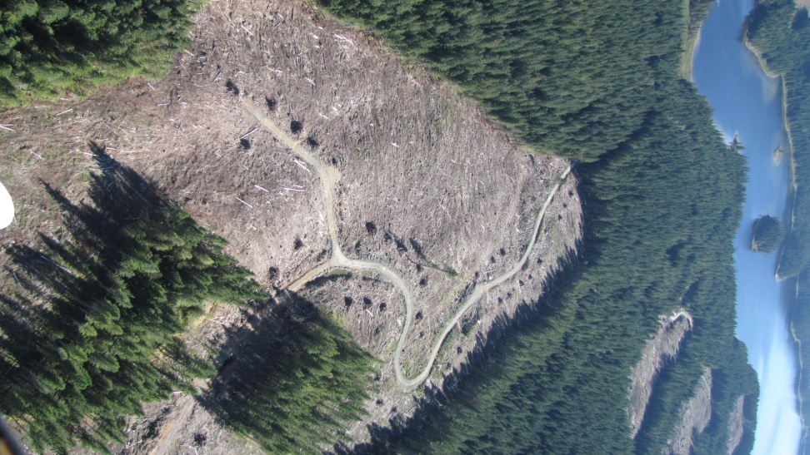
HAZARD ASSESSMENT
Hazard assessments must include assessment of fire hazard and risk of fire starting/spreading
– WR 11(4)(a)

Slide 8
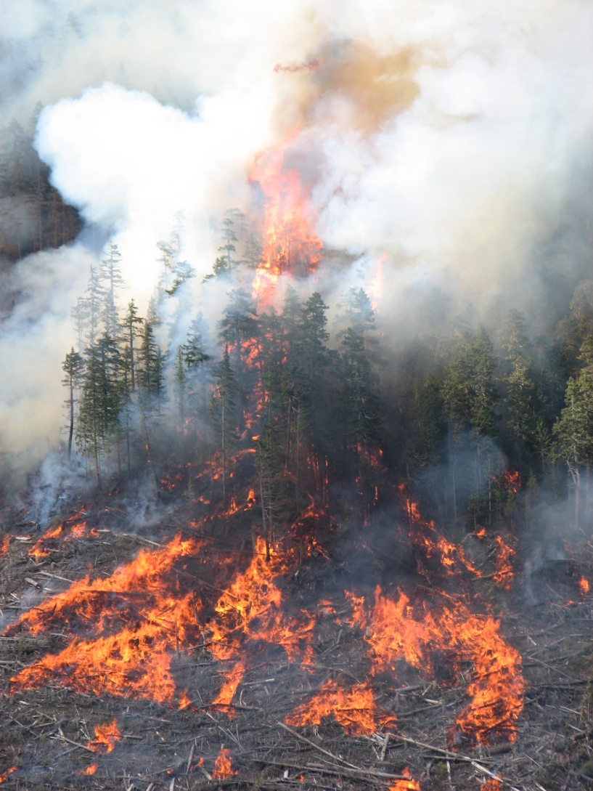
HAZARD ASSESSMENT
A person must abate fire hazard to levels that are not greater then prior to harvesting operations – WR 12(2)(a)(b) & 12.1(3)(i)(ii)
  Or, In the case of a qualified holder as specified by a RPF or RFT (with rationale) – WR 12.1(3)(b)

Slide 9
HAZARD ASSESSMENT
An official may identify circumstances they consider constitutes a fire hazard and by written order may require applicable person to abate said fire hazard by a specified date. The person who is subject to this order must comply – WA 7(3) and 7(4)

Slide 10
HAZARD ASSESSMENT
Scope of Practice – competent/qualified; experience, training, knowledge
Due diligence – rationale, peer review
Professional disagreement/accountability
Common sense, best practice, best science

Slide 11
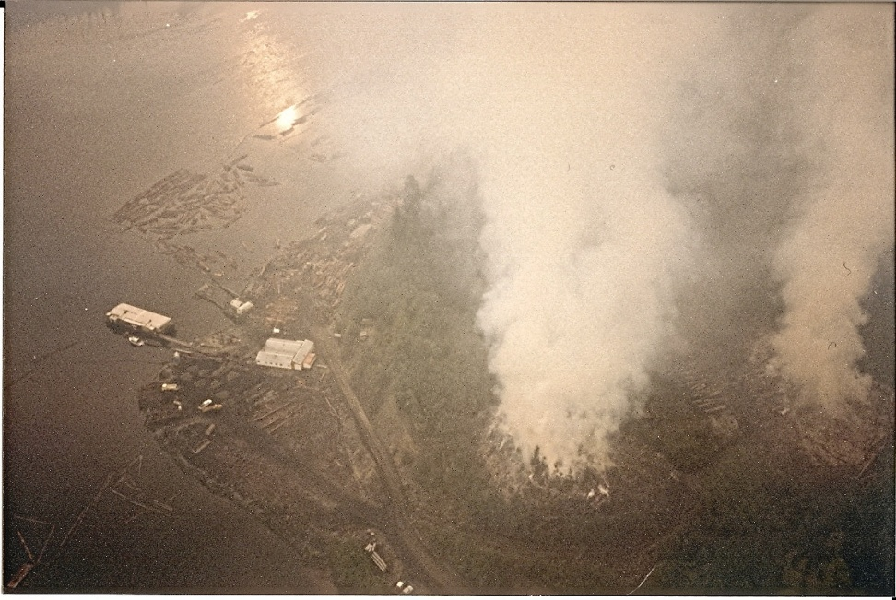
HAZARD ASSESSMENT
Exemptions – comprehensive fuel management plan
Exemptions – wet belt, other
Develop alternate assessment processes
FPB 2008 special Inv.

Slide 12
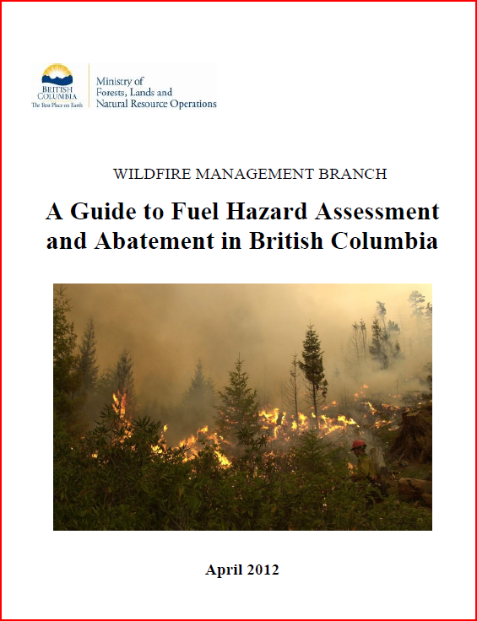
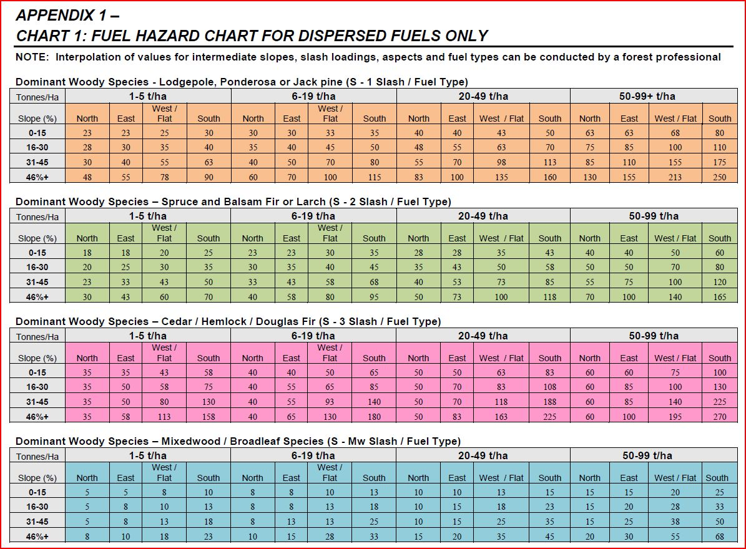
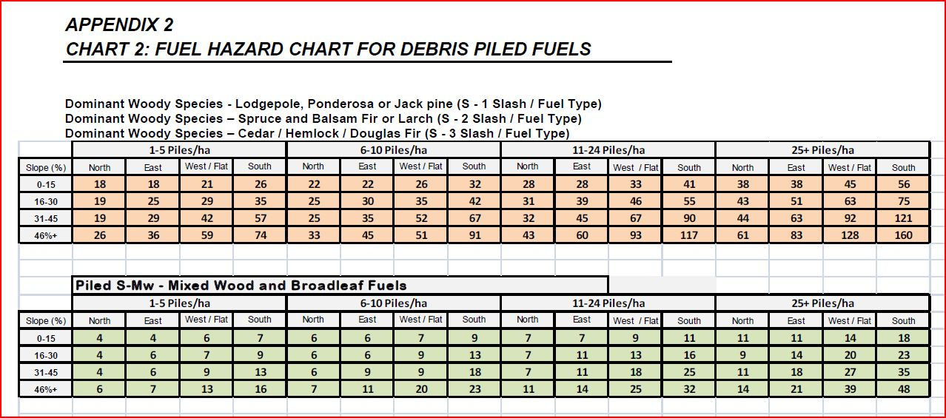
Guidance

Slide 13
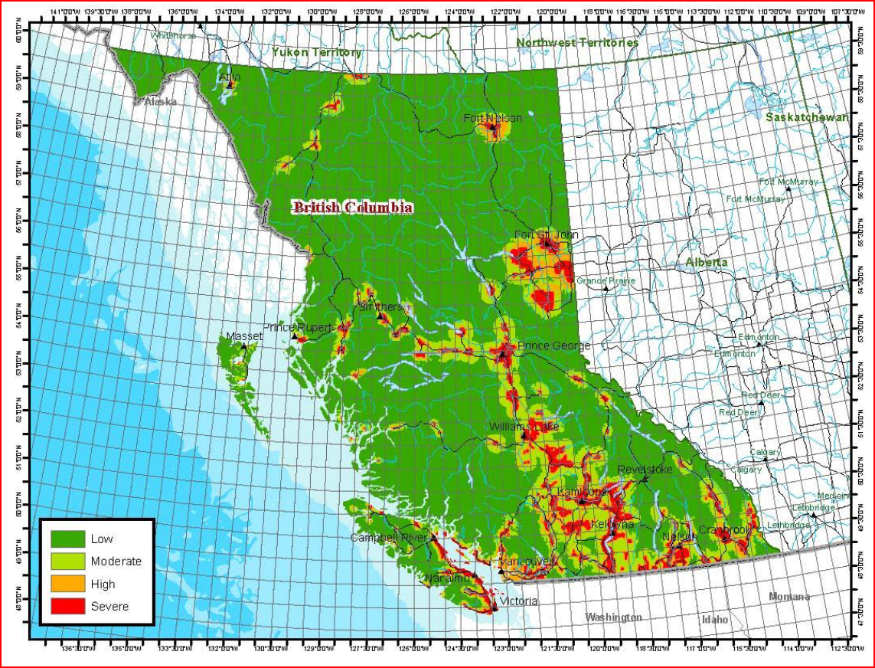
Risk Map

Slide 14
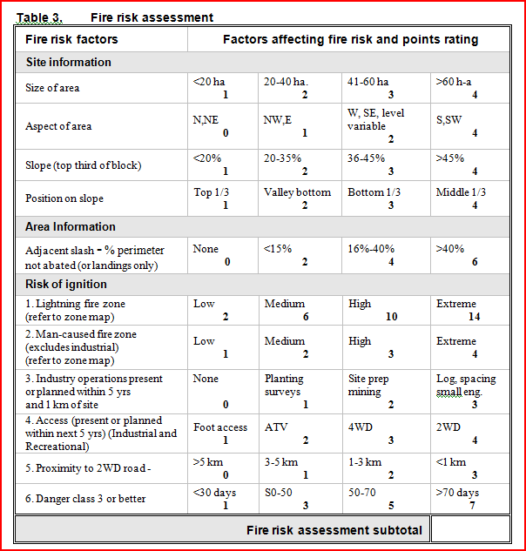
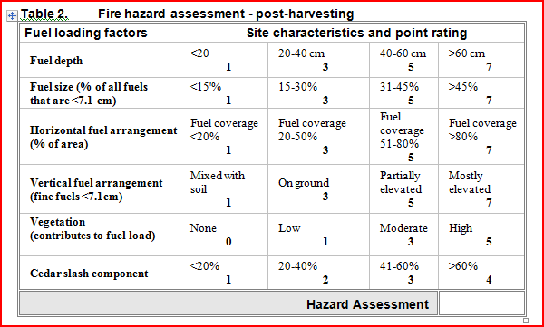
Schedule 7

Slide 15
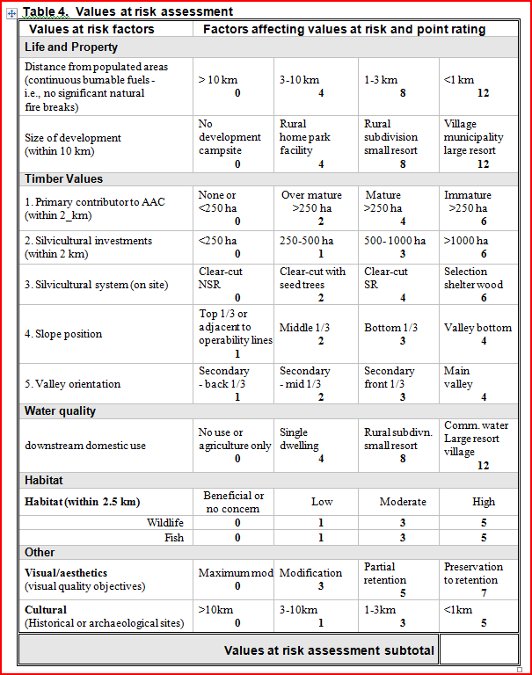
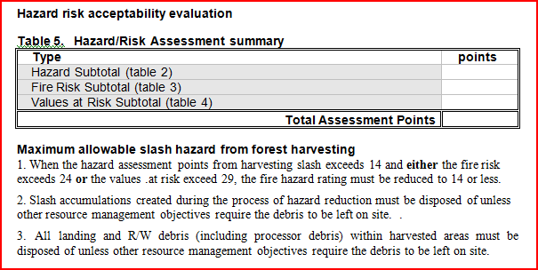
Schedule 7

Slide 16
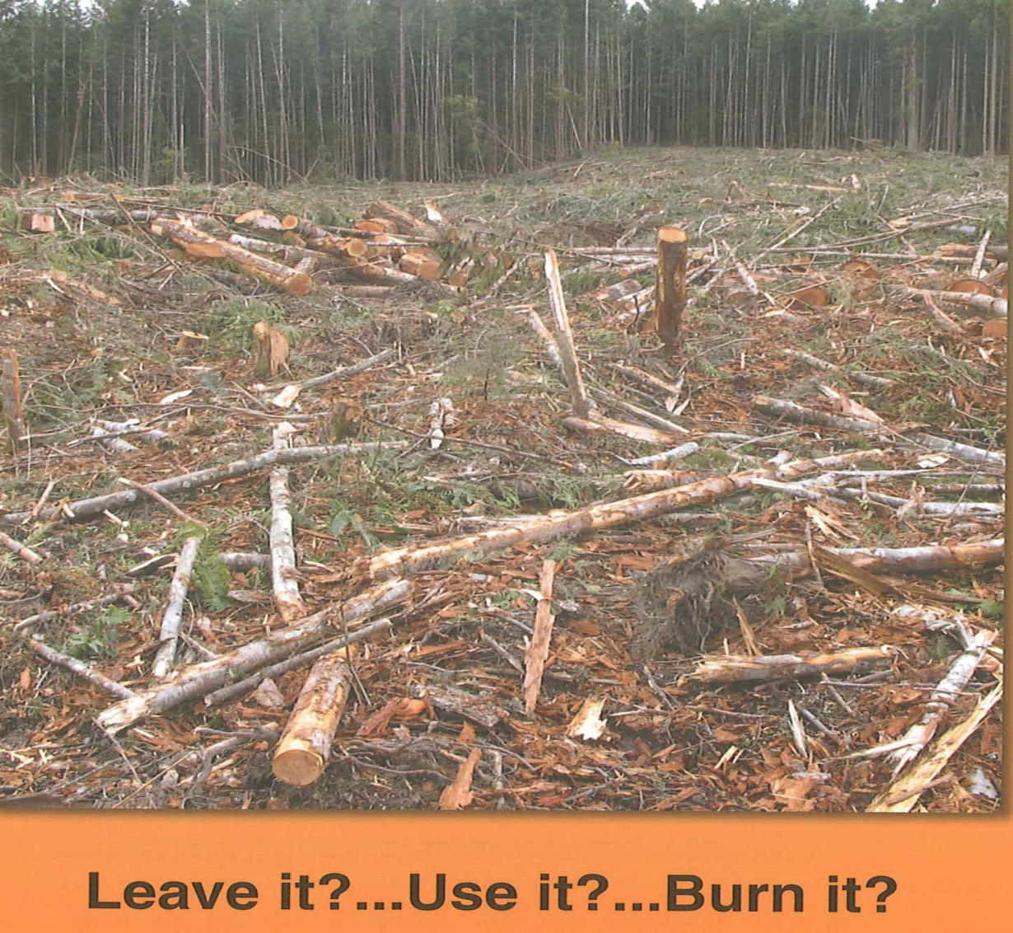
Best Practises

Slide 17
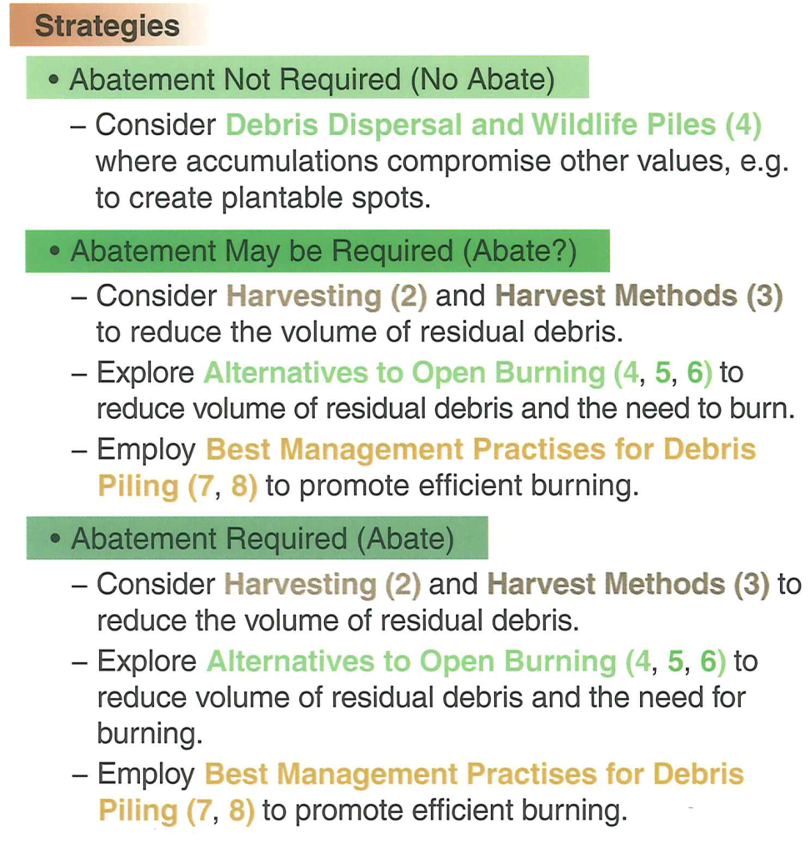
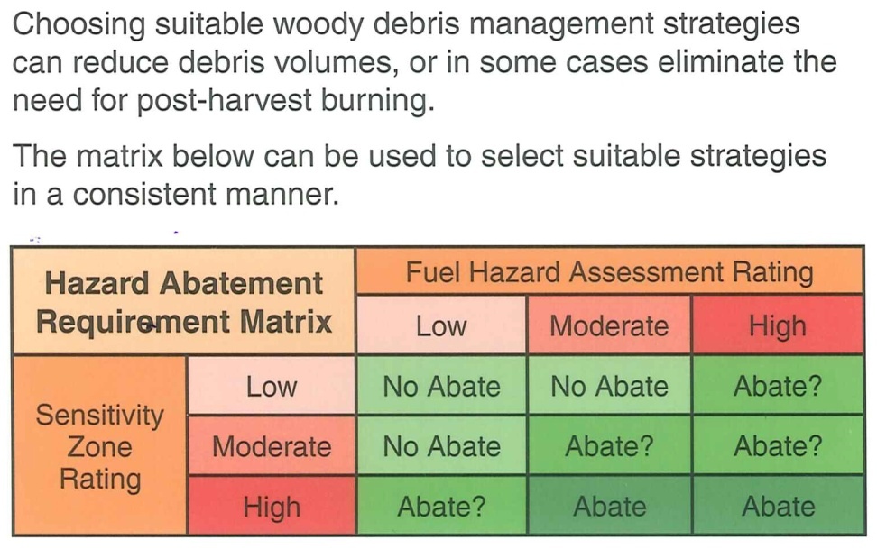
1. Woody Debris Management Strategies

Slide 18
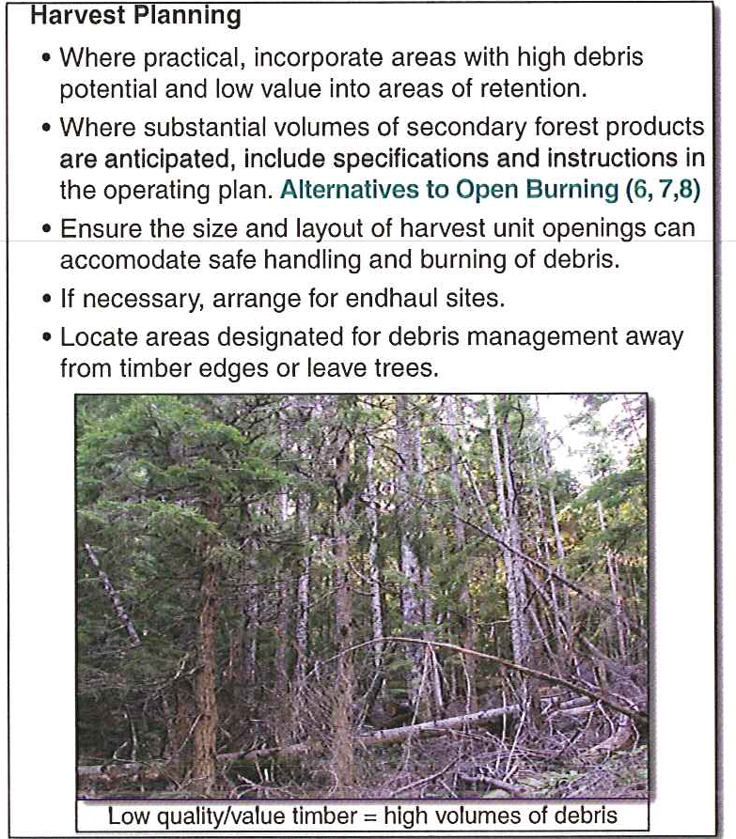
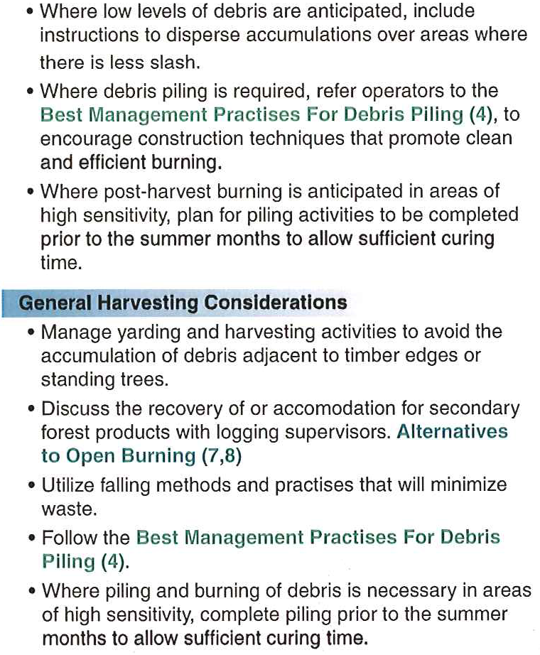
2. Harvesting

Slide 19
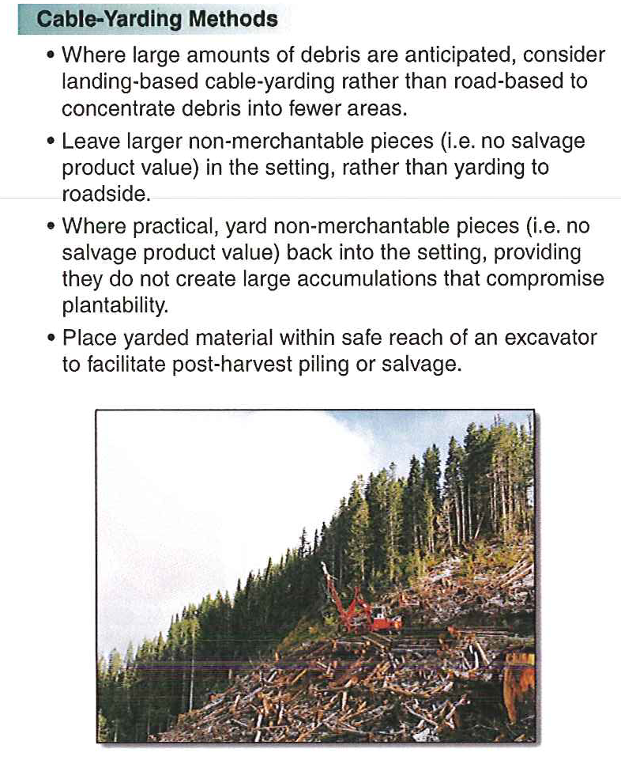
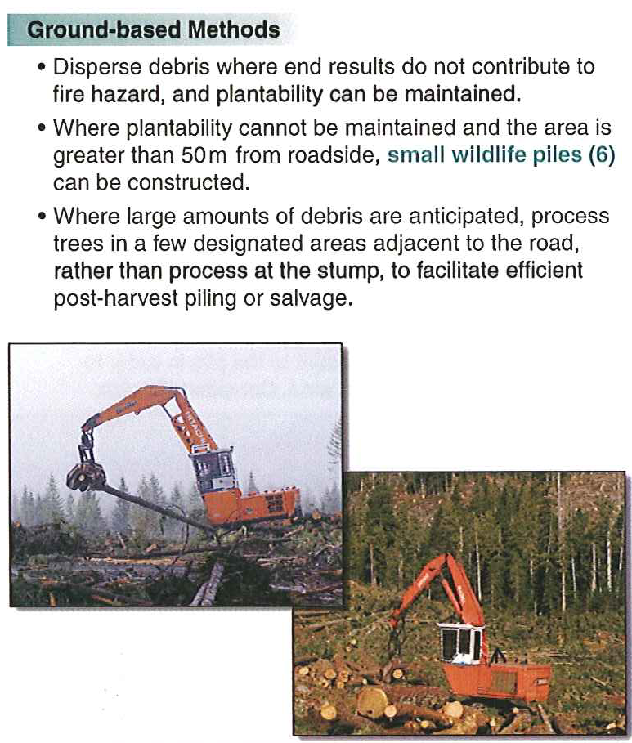
3. Harvesting Methods

Slide 20
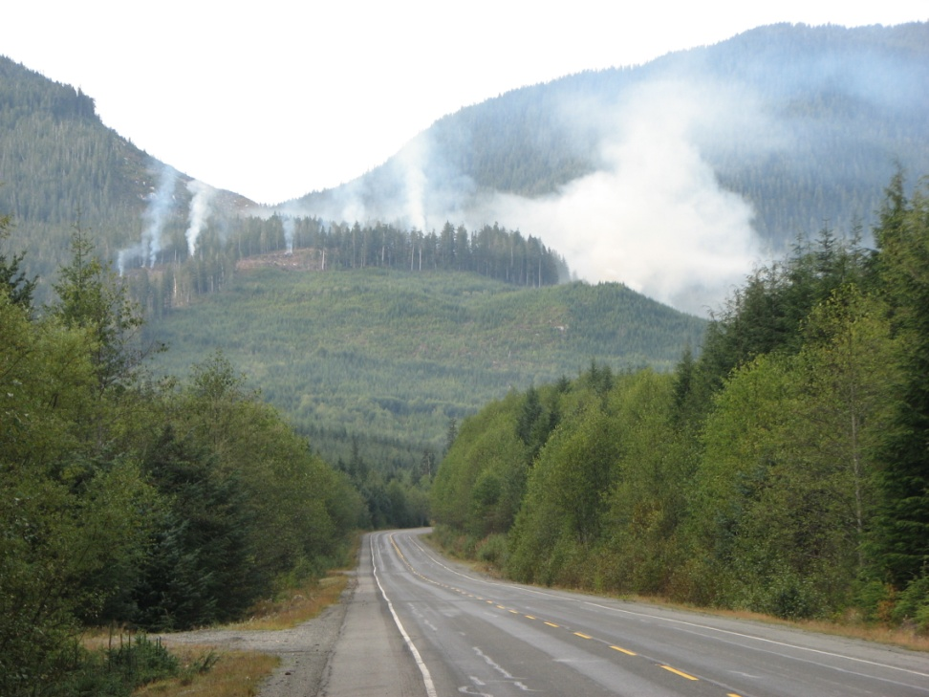
Secondary Tenures
Crown land only
Tenure limited to smaller area of operation within block

Slide 21
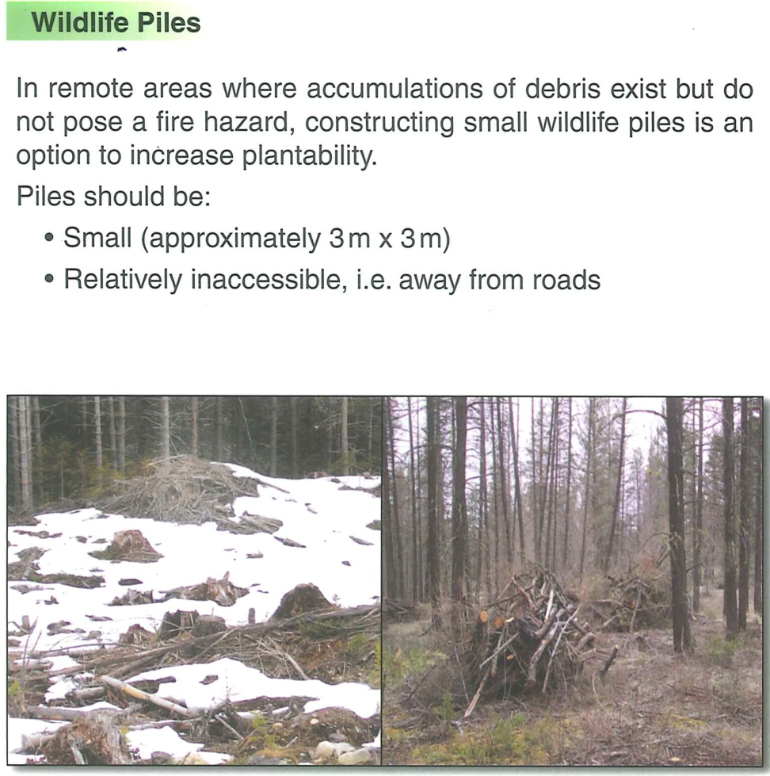
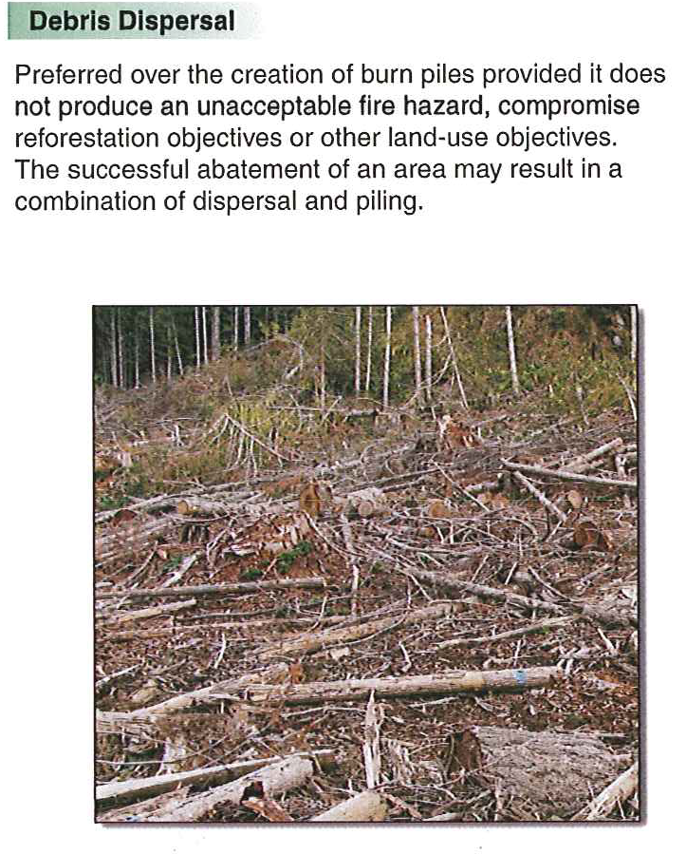
4. Alternatives to Open Burning

Slide 22
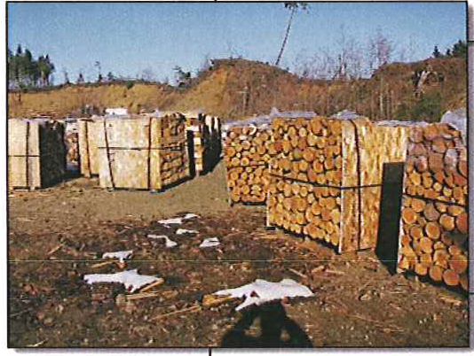
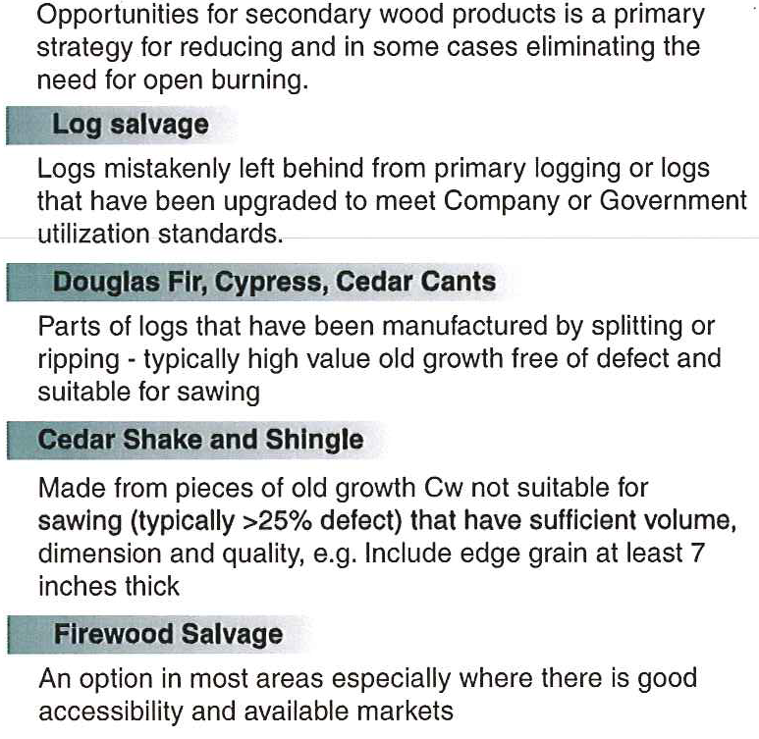
5. Alternatives to Open Burning

Slide 23
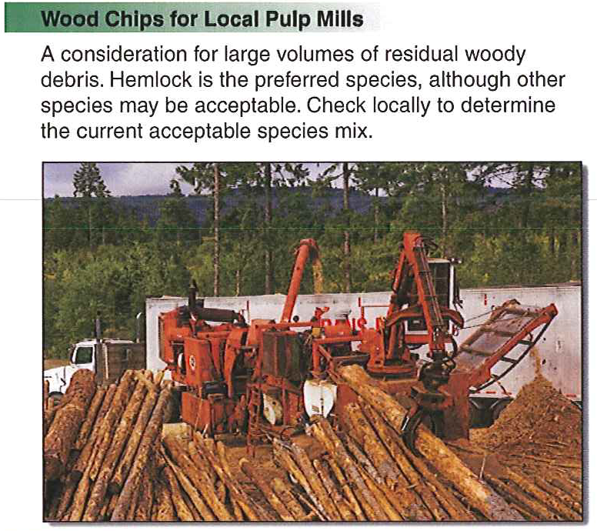
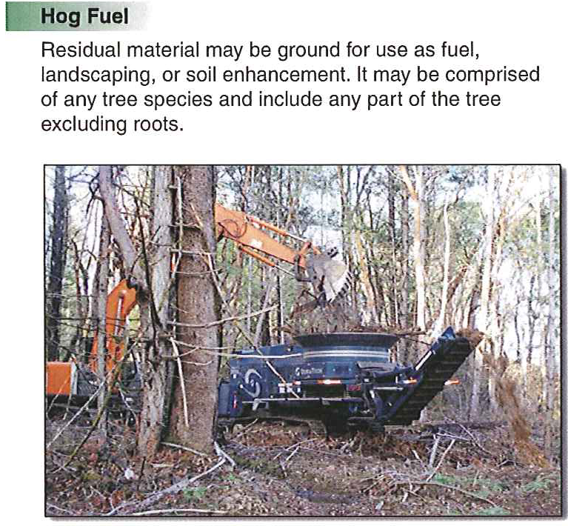
6. Alternatives to Open Burning

Slide 24
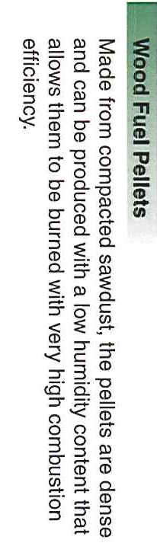
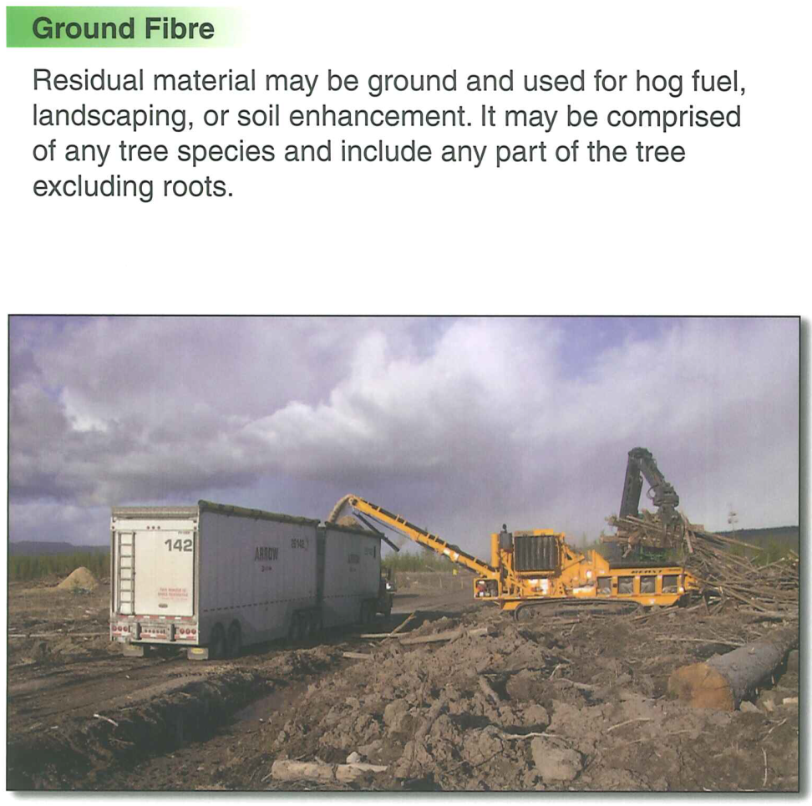
6. Alternatives to Open Burning

Slide 25
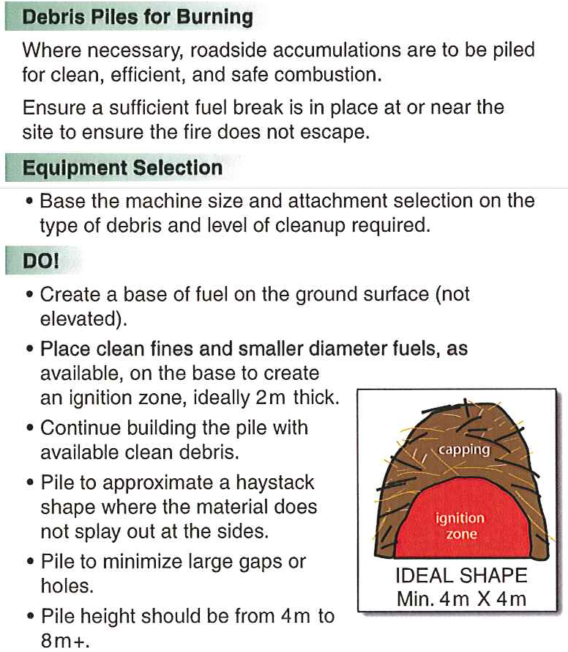
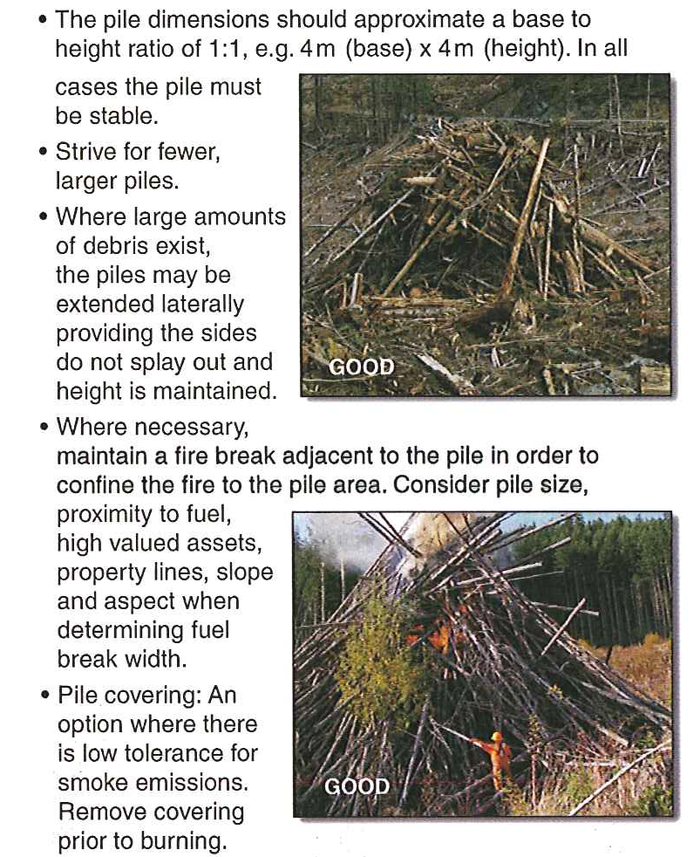
7. Best Practice – Debris Piling

Slide 26
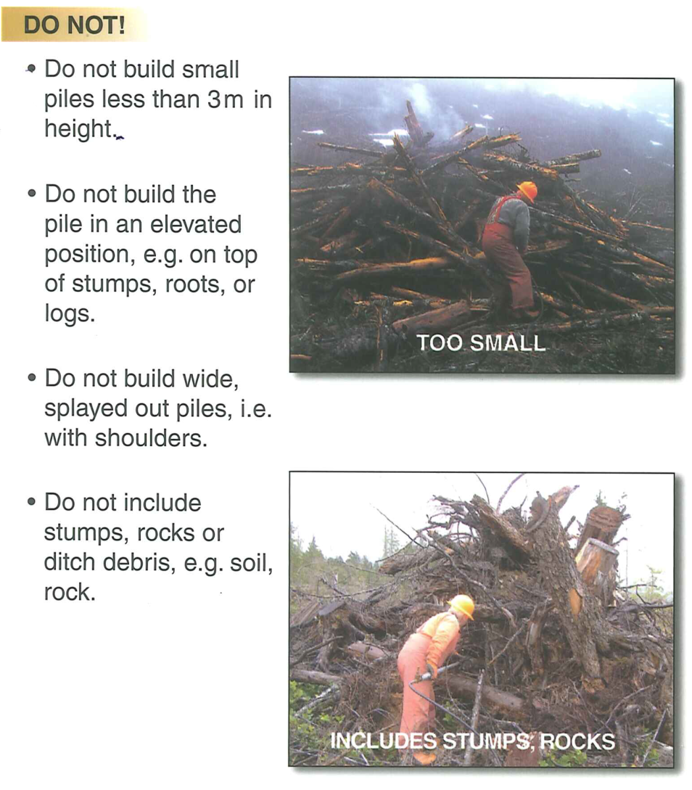
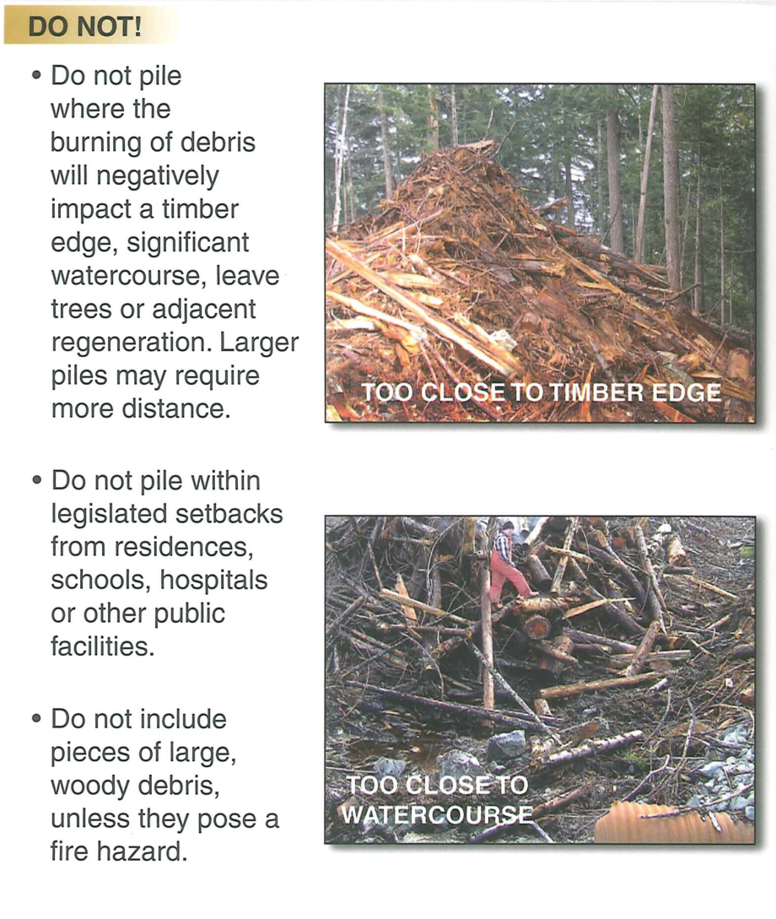
8. Best Practice – Debris Piling

Slide 27
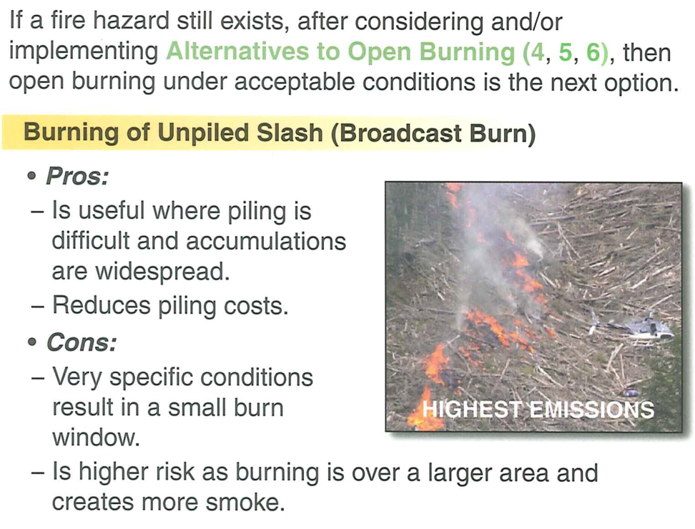
9. Open Burning
Wildfire Act & Reg
Environmental Management Act (EMS)
Open Burning Smoke Regulation (OBSCR); venting
Regional Districts & Municipal Jurisdiction; Bylaws
Category 3; Reg. #
Resource Management Burn; Reg. #

Slide 28
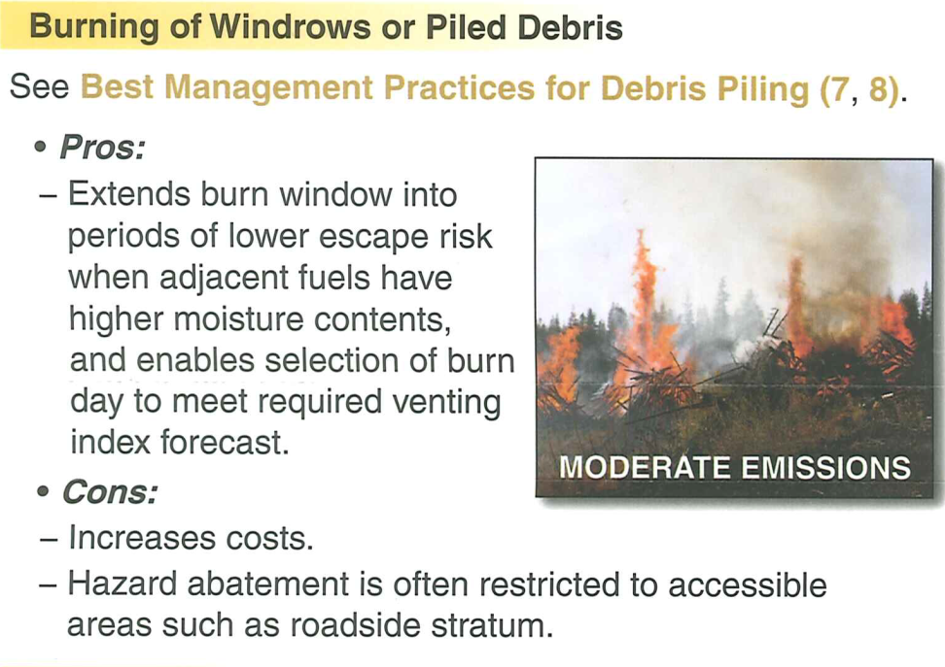
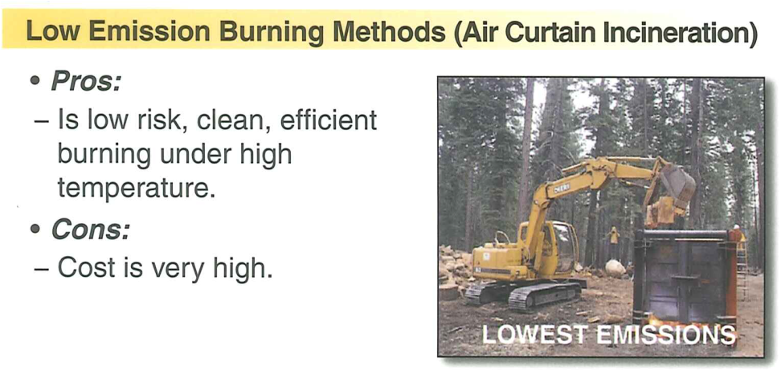
9. Open Burning

Slide 29
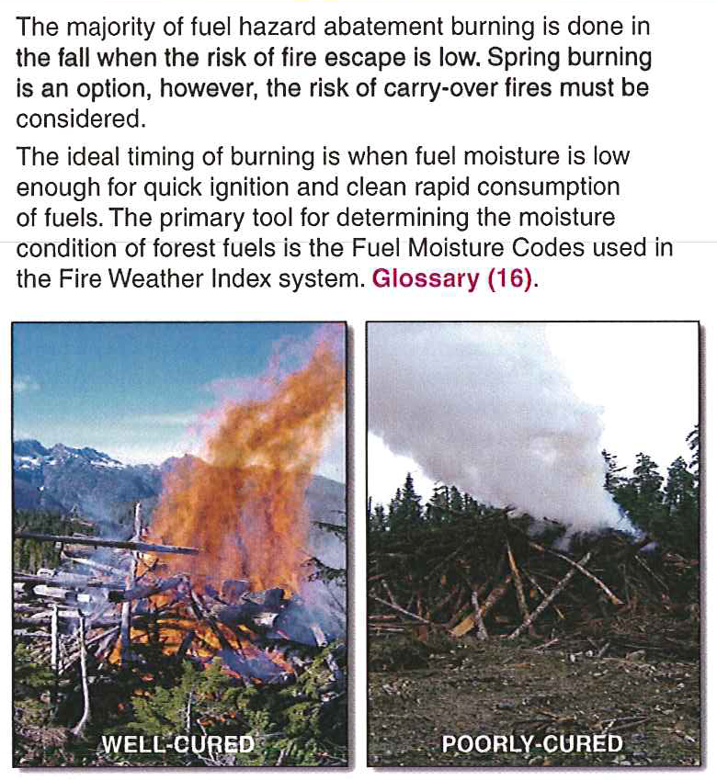
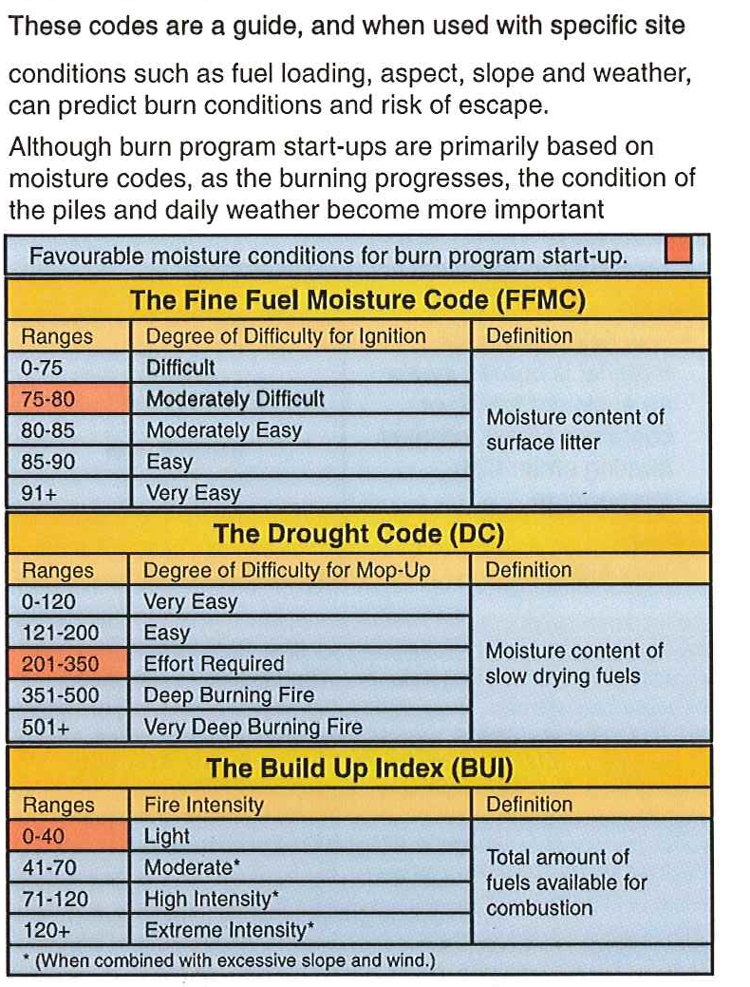
10. When to Burn (FWI)

Slide 30
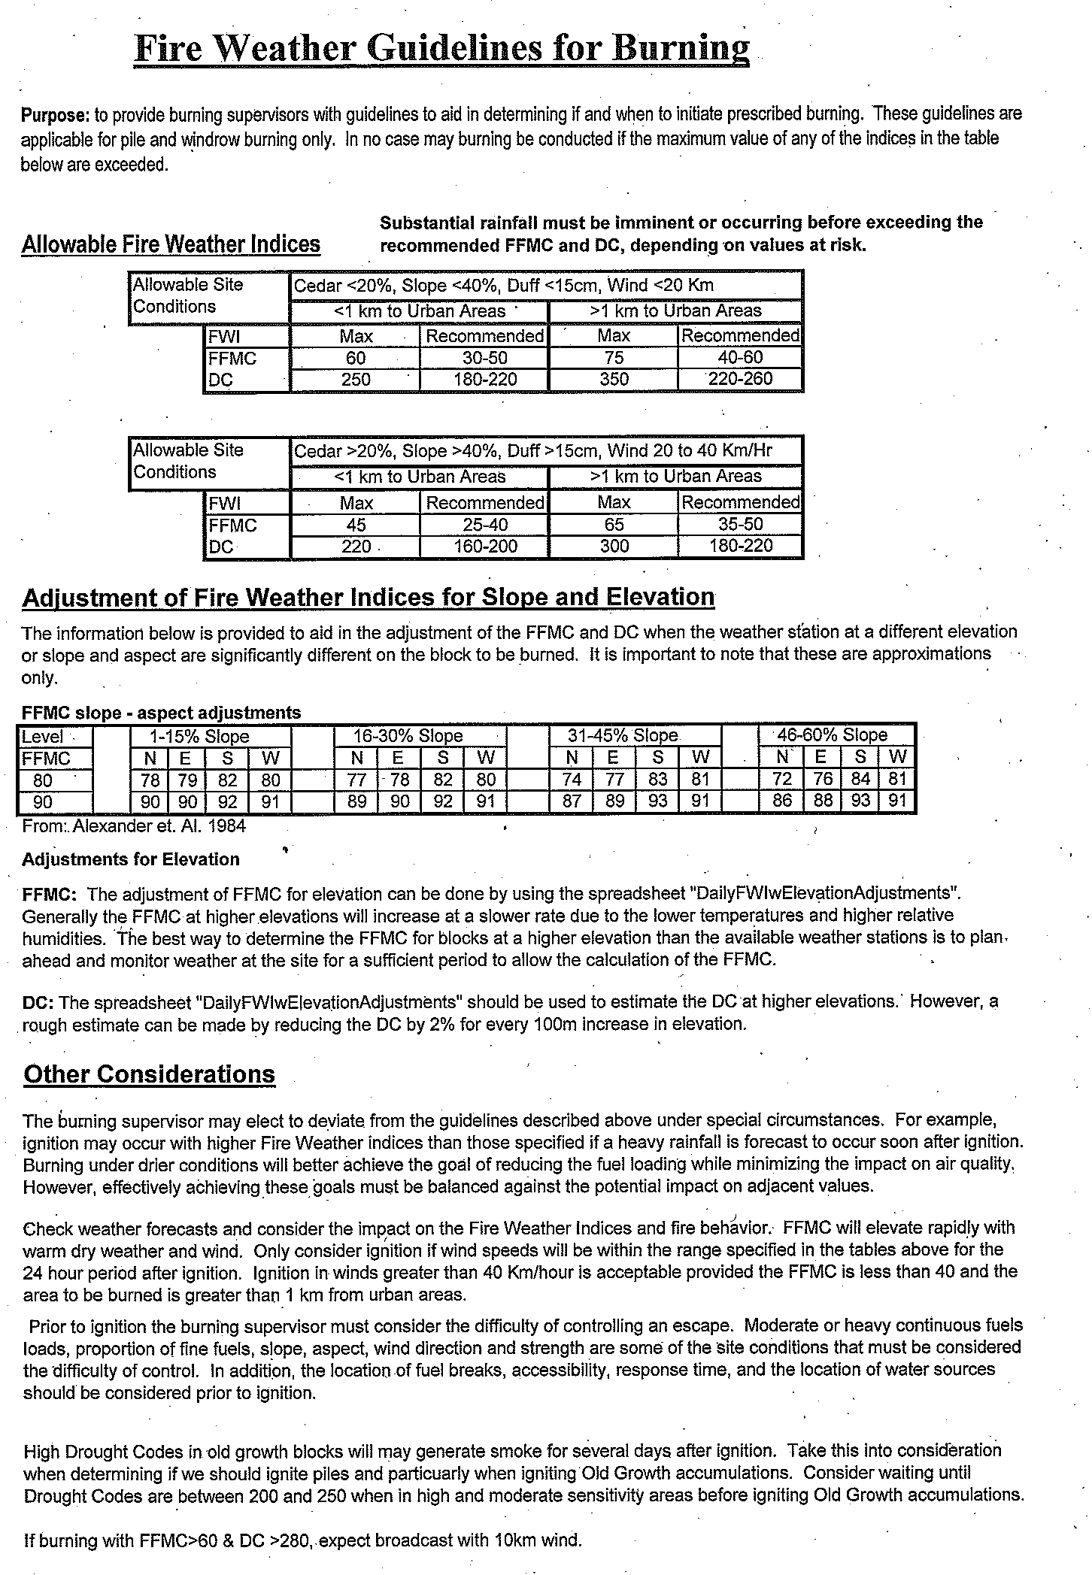
10. When to Burn (FWI)
Safe conditions to burn & continuing to be safe
Weather Forecast
Venting Forecast
  Environment Canada
  Custom

Slide 31
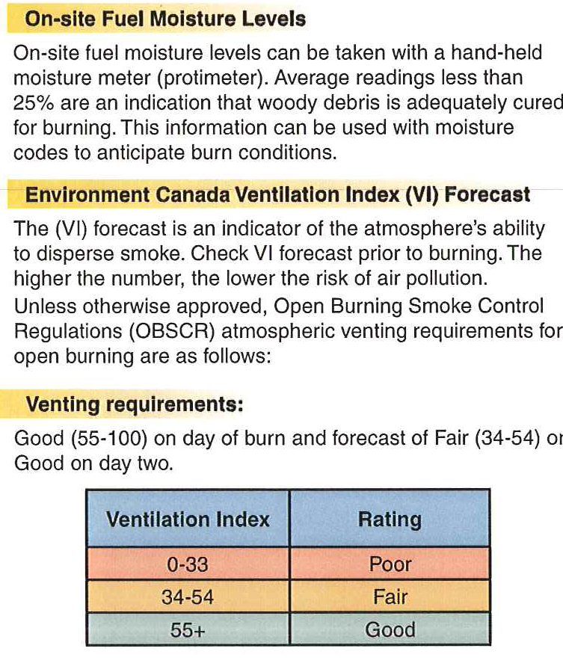
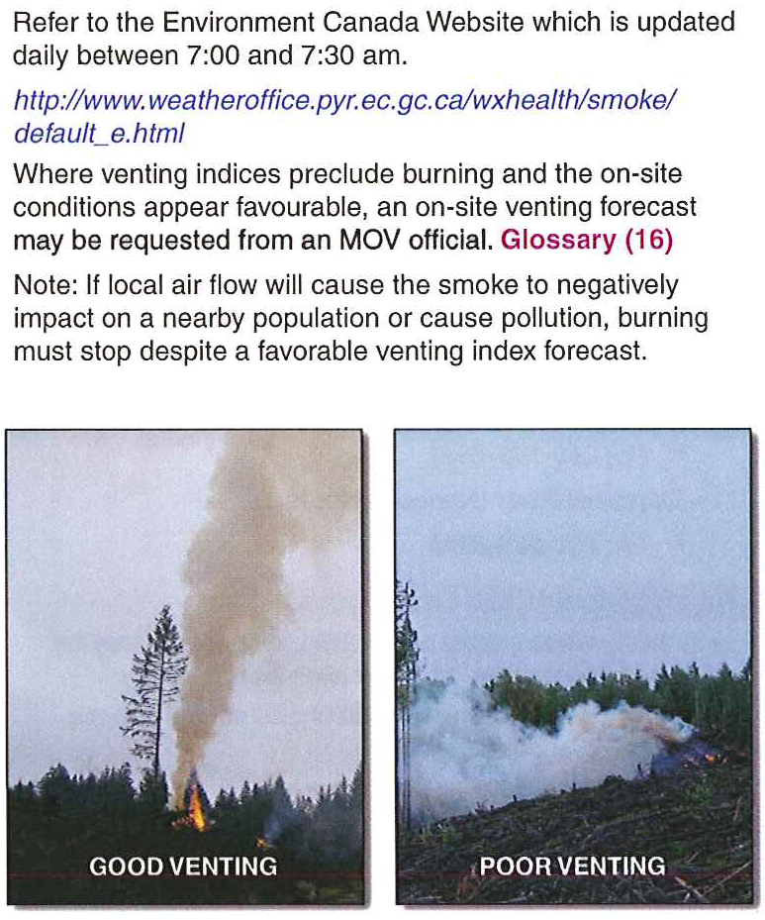
11. When to Burn/Venting Index

Slide 32
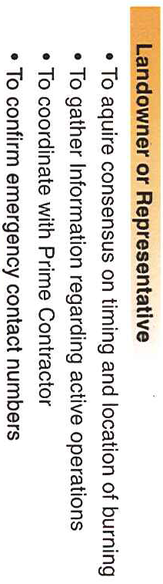
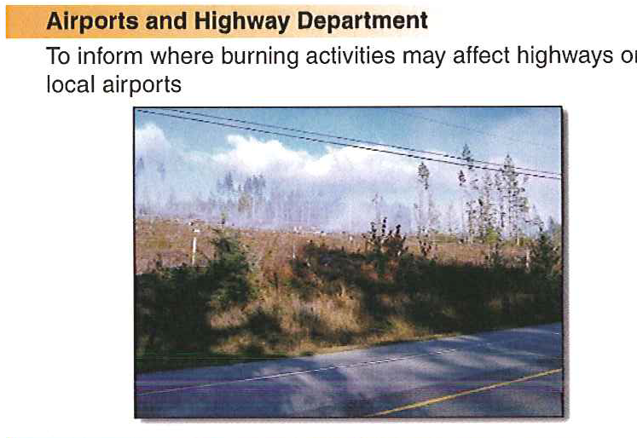
12. Notifications Prior to Burning
Public media campaign – radio/newspaper?

Slide 33
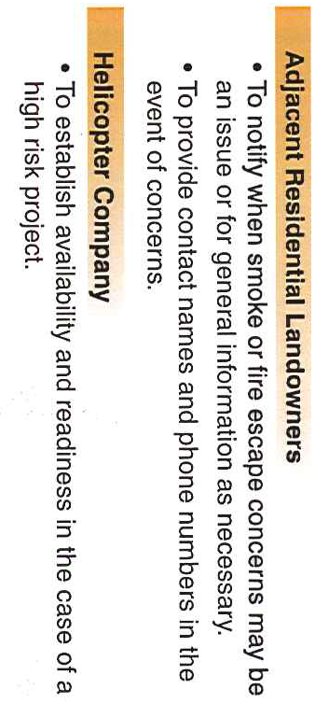
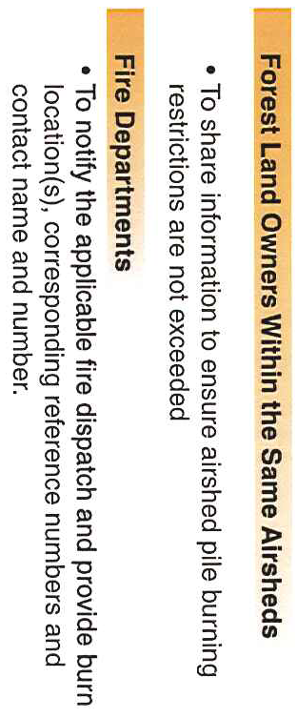
12. Notifications Prior to Burning

Slide 34
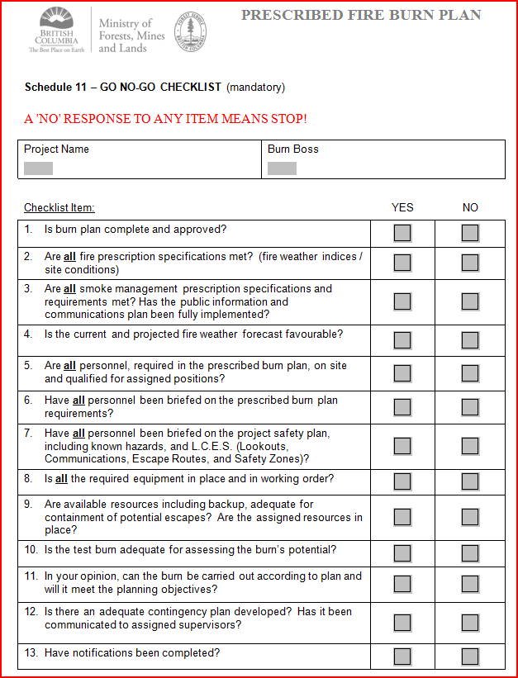
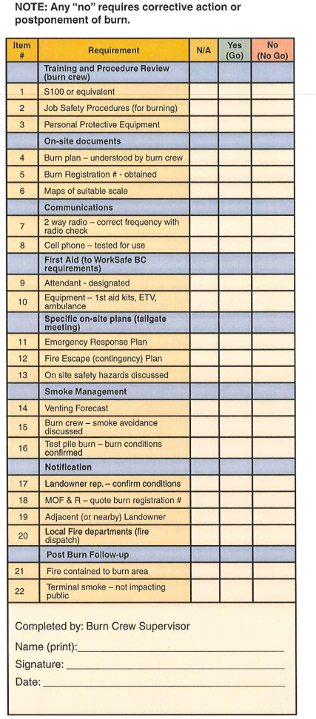
13. Burn Checklist

Slide 35
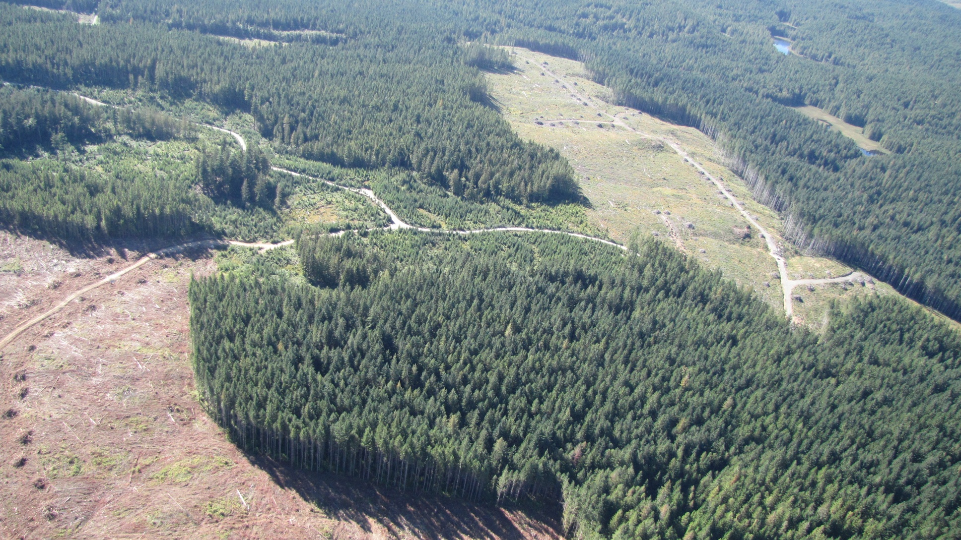
IF YOU BUILD IT; BURN IT!!!

Slide 36
Weather Stations
Ensure representative weather station for industrial operations. WR 6(2)(a)
Option 1 – WMB rental. $3000 per year rental, plus extraordinary costs (heli)
  Set up
  Data
  Forecast
  Equipment availability dependant

Slide 37
Weather Stations
Option 2 – purchase Similar WMB hardware. $16,000 + -
Option 3 – purchase from a multitude of small portable stations.
  $1000 to $20,000
  start up codes
  Software; coming soon CFS online software

Slide 38
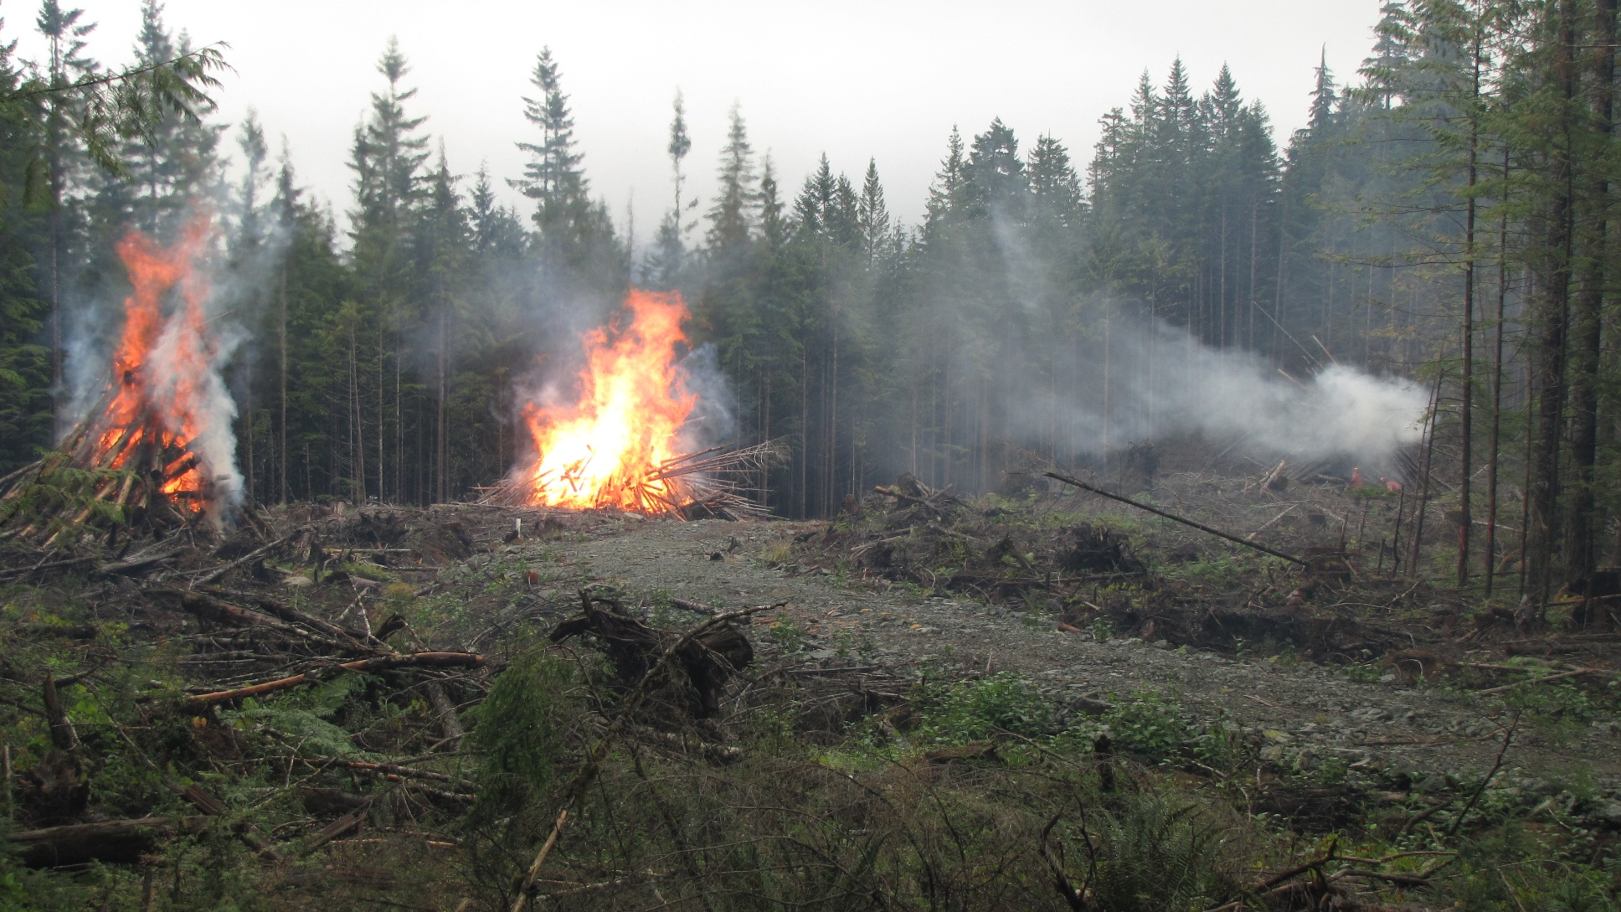
QUESTIONS?

